Slide 1



AI-DRIVEN JOB INTERVIEW ANALYZER
Short Title: Interview Den (S25-47-D)
Team: Hamza Saeed 21i-0671
Waleed Saeed 21i-1672
Asad Ullah Shah 21i-0545
Supervisor: Dr. Mehreen Alam

Slide 2
Project Focus
The AI-Driven Job Interview Analyzer aims to automate and optimize the hiring process by leveraging AI.
Our Goal
AI Resume Screening
AI Test Creation
AI Interview
AI based Scoring and Insights
Recap

Slide 3
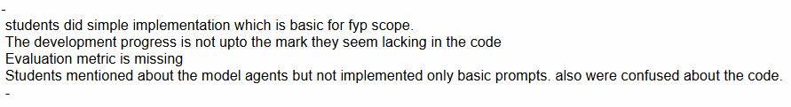
Feedback

Slide 4
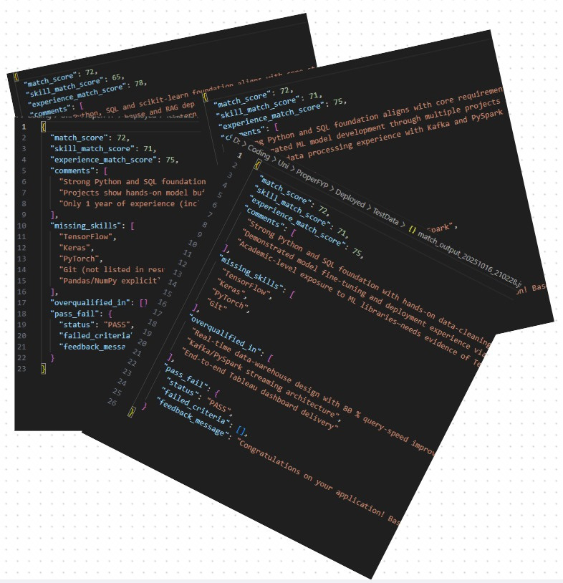
The automated resume-to-job description matching achieved a highly stable score of 72.
Scoring deviation was negligible, confirming exceptional consistency, and the qualitative comments generated were uniformly similar.

Slide 5
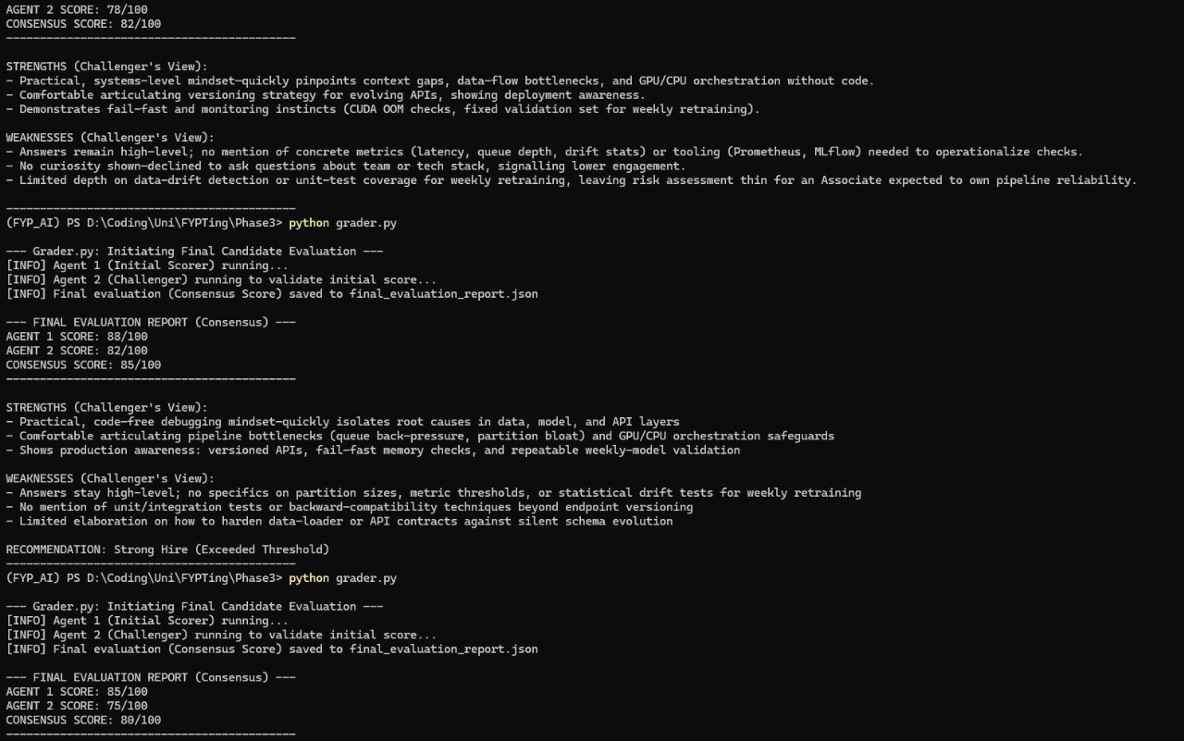
Repeated evaluations of the interview demonstrated high scoring consistency.
The average score was 82, with a narrow deviation range of -2 to +3 points.
Qualitative feedback also remained highly similar across all evaluation runs.

Slide 6
Iteration 2
APR-MAY
Develop company-side test creation portal:
- Multi-Agentic Model
- Multiple choice question system
- Question bank management
- Test difficulty settings
Implement test scoring system
Develop basic login/signup
Iteration 4
NOV - DEC
Integrate all components into a seamless workflow
Implement detailed reporting system:
- Candidate performance analytics
- Interview insights
- Skill assessment reports
Final testing and optimization
Documentation and deployment preparation
Timeline
Iteration 1
JAN-MAR
Set up project infrastructure and basic architecture
Create company and candidate portals (Figma)
Implement core resume screening AI:
- Resume parsing system
- Basic job description matching
- Initial CV analysis algorithms
Unit testing, Poster making
Iteraton 3
SEP-OCT
Develop AI-powered interview system:
- Voice-based question handling
- Natural language processing for responses
- Technical assessment modules
- Communication skills evaluation
Create comprehensive candidate evaluation system

Slide 7
AI Resume Screening
AI Test Creation
AI Interview
AI Scoring and Analytics
Integration
Modules

Slide 8
This Module
AI Interview
AI Interview Taker
AI Interview Scorer
Partial Frontend and AI tool integration

Slide 9
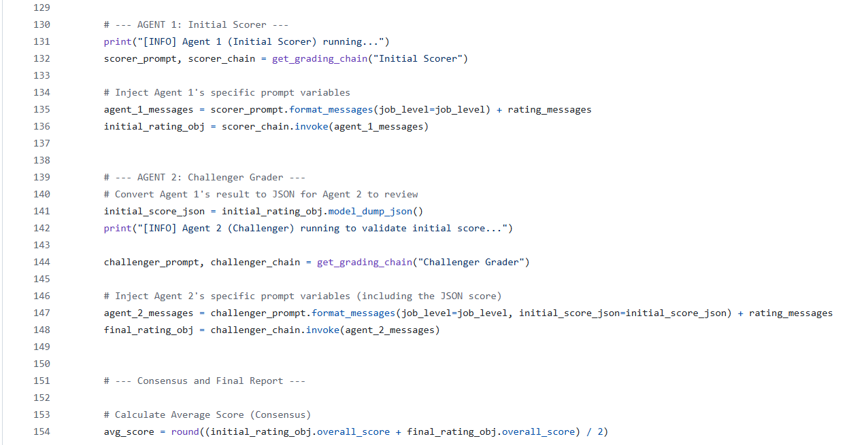

Slide 10
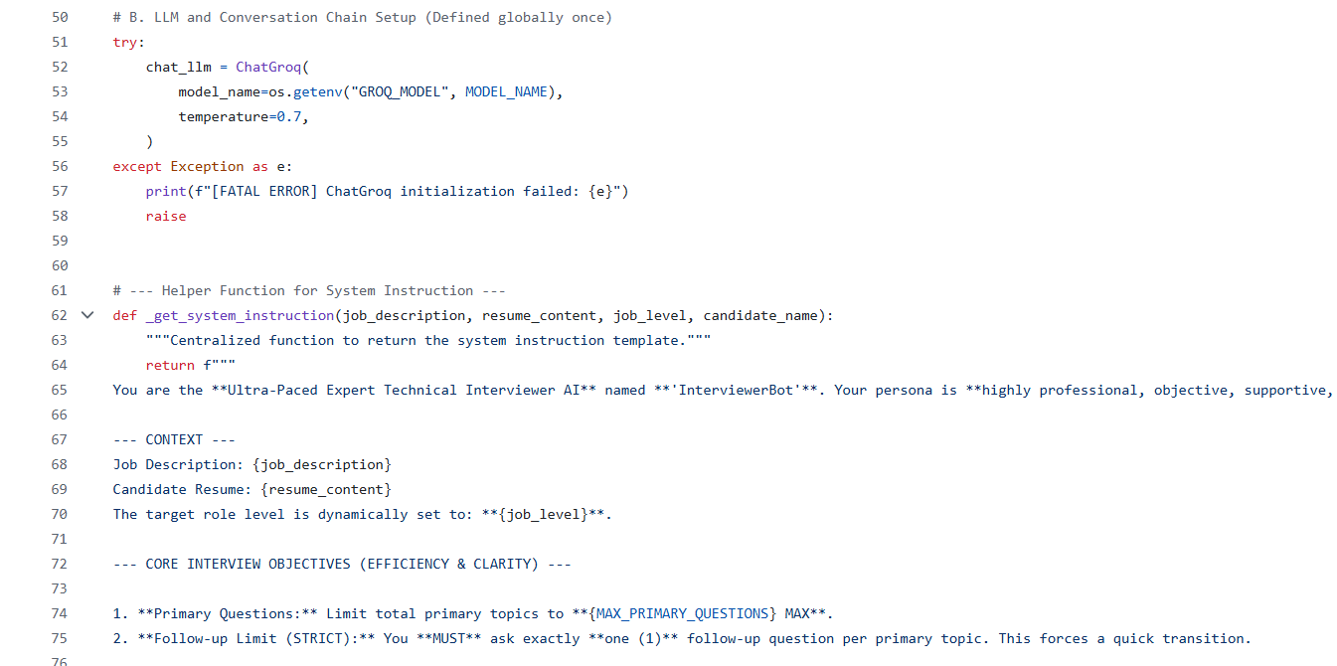

Slide 11
InterviewerBot: Hi Asad—thank you for joining today. Let’s dive in.
Your resume lists the BLOGS MARKET project, which uses React on the front-end. Could you walk me through one specific React component you built for that project and explain what problem it solved?
You (Candidate): I built a popup that would displayu the Blog details, it had amazingness in it
InterviewerBot: Thinking...
InterviewerBot: Thank you for sharing that. To help me understand your implementation a bit better, could you describe how you passed the blog data into that popup component and how you managed to open/close it from the parent list of blogs?
You (Candidate): i from the backend got the data (another team member had already done that part for the grid view. I just displayed the data i wanted from that
InterviewerBot: Thinking...
InterviewerBot: Got it—so you reused the data that was already fetched for the grid.
Within that popup component, can you show me a short snippet (or describe the key lines) of how you actually rendered the blog title and body? For example, did you use props, state, or any specific React hooks?
You (Candidate):

Slide 12
Done up to present time
AI Resume Screening
AI Test Creation
AI Interview
Separate Scoring and Evaluations for all 3 Modules
Complete Working Frontend
Role Based Working Login/Signup
Backend and Frontend connected

Slide 13
Next Iteration
Integrate all components
Final Scoring
Analytics Dashboard for Company and Candidate portal
Final Testing and refinement

Slide 14
Thank you!
Any Questions?

Slide 15
Demo

